Slide 1
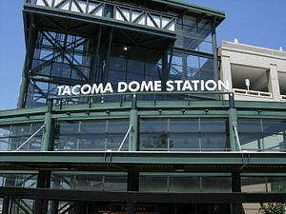
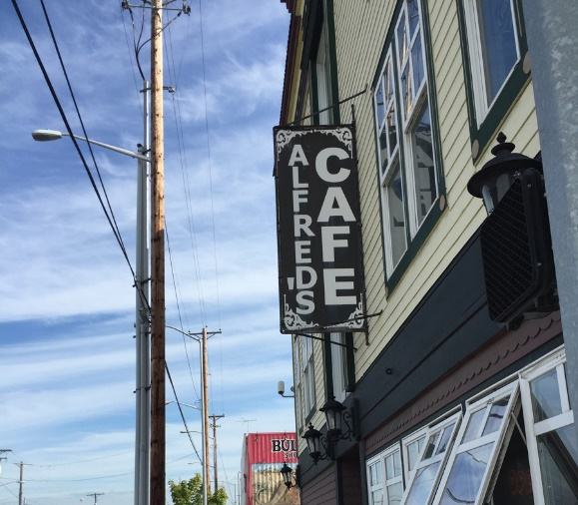
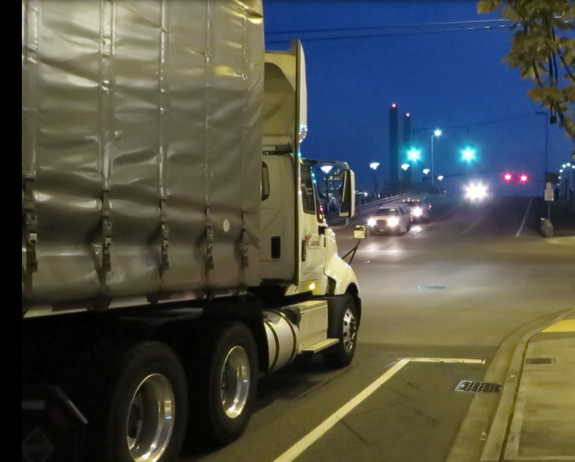
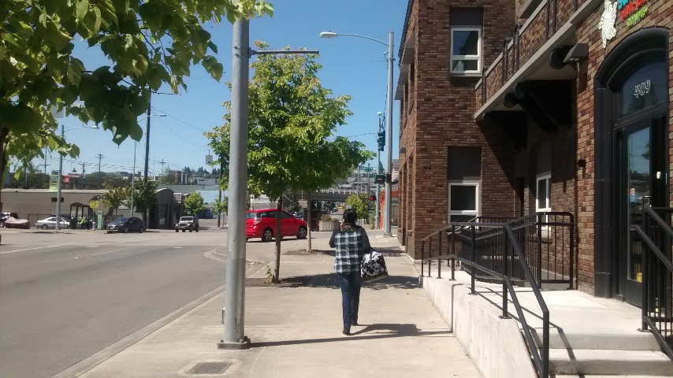
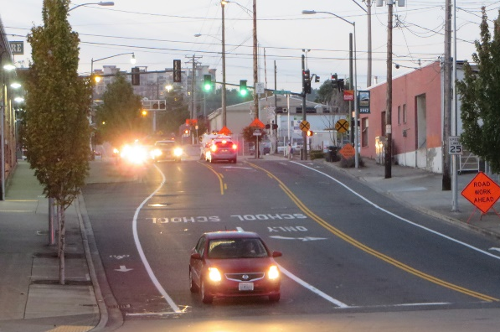
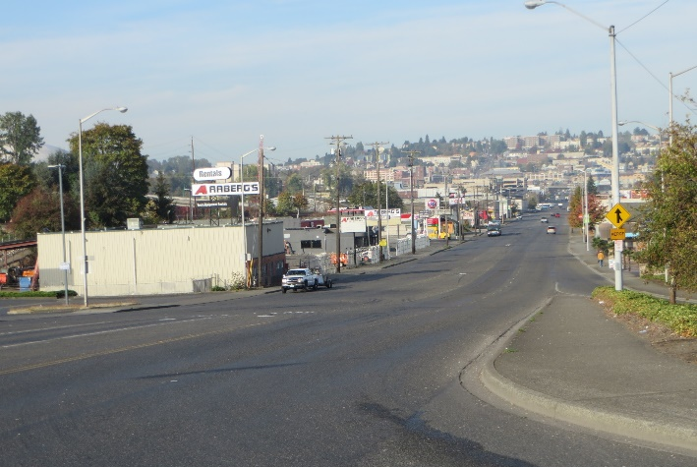
Puyallup Avenue Transit/Complete Street Improvement Project Conceptual Phase Evaluation
Transit-Oriented Development Advisory Group (TODAG)
December 21, 2020

Slide 2
Current Schedule
TODAG provides recommendations to Transportation Commission by their January 20th meeting regarding following alternatives:
Construct the project as proposed in the grant application (including reconfigured on-street parking/loading/rideshare zones)
Request removal of HOV lane between E. C St. & E. G St.
Return the grant to the funding agency
Transportation Commission receives TODAG and BPTAG recommendations, updates prior recommendations as needed
PW works with PSRC to understand impacts of removal of HOV/Transit lane between E. C and E. G Streets
PW presents to the Infrastructure, Planning and Sustainability Committee in March
Assuming grant moves forward:
Funding obligation begins April–May
Design: June/July 2021 - December 2023

Slide 3
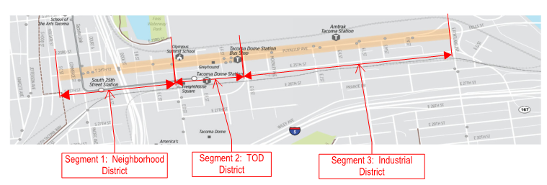
Project/Grant Summary
From S. C Street to Portland Avenue:
1.2 Miles of reconstructed heavy-haul roadway
Sidewalks, curb ramps, crosswalks, bicycle facilities, landscaping
New fiber backbone, signals, APS, lighting
Generally 1-WB lane, CTL, 2-EB lanes (one is HOV/transit)

Slide 4
Project Goals
Support multimodal uses and embrace complete street concepts
Enhance the experience for everyone, including pedestrians, cyclists, drivers, transit riders, and freight operators
Make Puyallup Avenue an inviting place where people want to visit

Slide 5
Project Outreach
October ‘16
Stakeholder Focus Groups (2)
In-Person Surveys (90 completed)
November ’16
Online Survey & Mapping Tool (212 responses)
Stakeholder Design Charrette/Site Walk
Public Design Charrette
June ‘17 – Public Open House
June/July ‘17 – Collected online feedback on alternatives
Technical Advisory Meetings
September ‘16
November ‘16
May ‘17

Slide 6
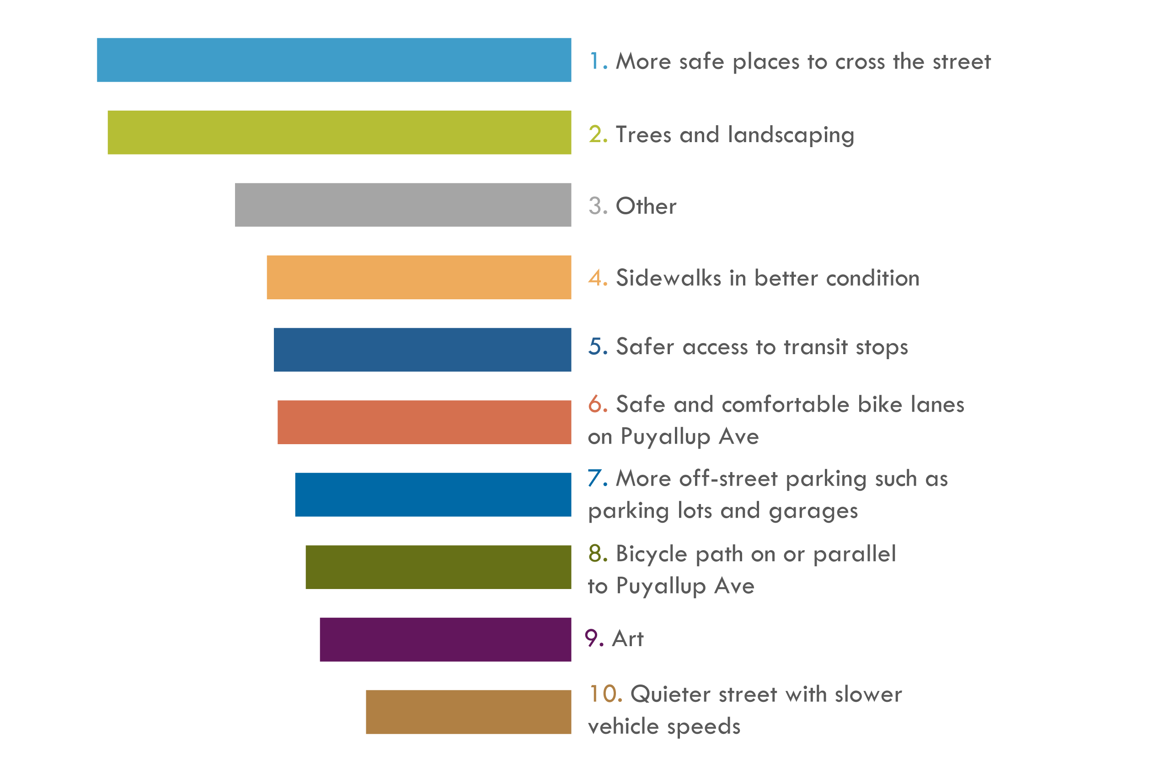
What We Heard: Public Feedback
In terms of transportation, what would make Puyallup Avenue more attractive to you?
Other: Safety/streetlight/ storefront improvements, road maintenance, better transit/ped/bike connections, more retail/mixed use destinations, noise reduction (train/construction), parking, gateway features
Notes:
This is the list of the top TEN overall results.
Examples of “Other”:
Safety
Street lights
Storefront improvement
More retail/mixed use
Better transit/ped/bike connections
Road maintenance (potholes)
Noise (trains and construction)
Parking
Gateway features

Slide 7
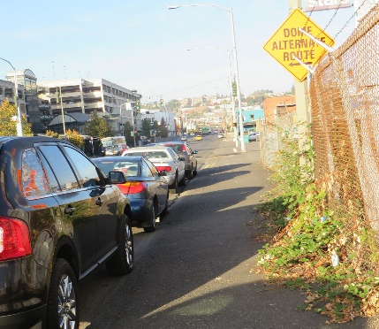
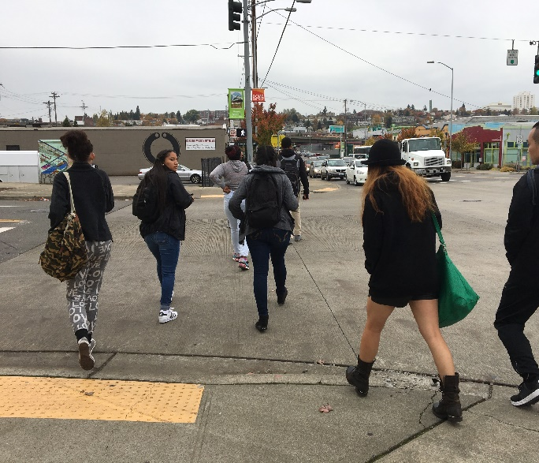
What We Heard: Stakeholder Feedback
Want Subarea Plan efforts to come to fruition
Need access to TDS
Parking is increasingly an issue
Must be be safer and more comfortable for pedestrians, especially students
Doesn’t currently feel like a safe street to bike
Preserve the unique historic and industrial character
Acts as a gateway for people arriving in Tacoma by transit or for events
Make it feel like a place

Slide 8
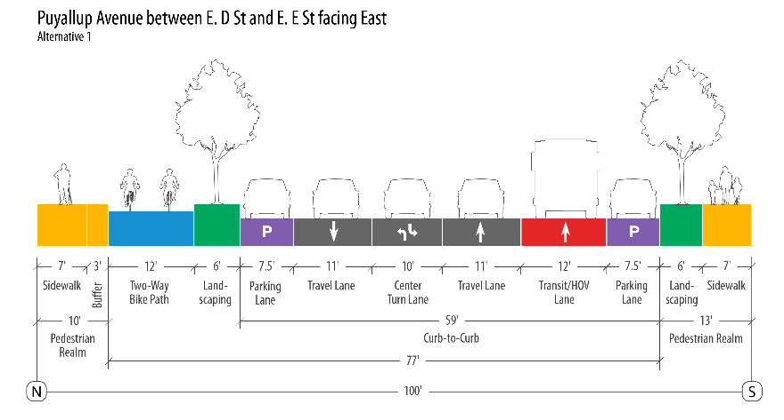
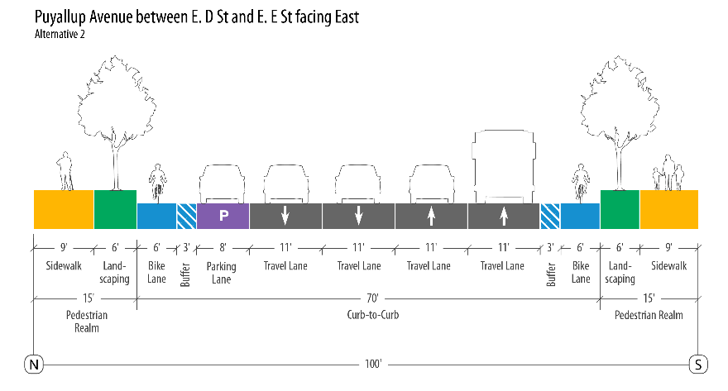
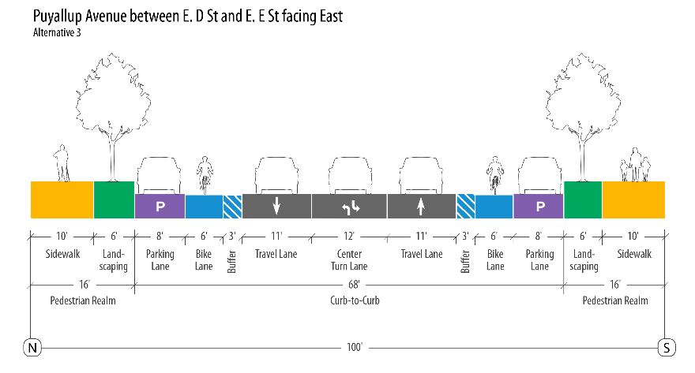
Proposed Alternatives 1-3

Slide 9
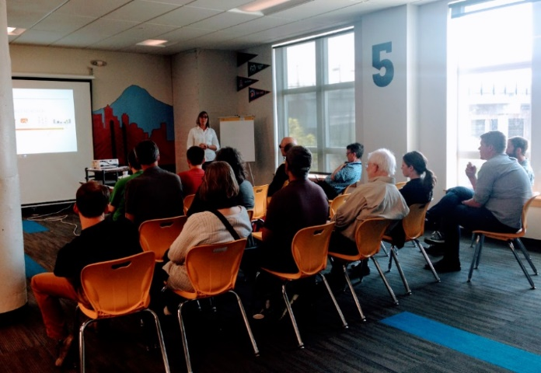
Outreach Summary
Most Preferred Items:
Parking Protected bike lanes (Alt. 2)
Parking management/reduced on-street parking (Alt. 2)
Wide sidewalks/separation from traffic (Alt. 3)
Transit & High Occupancy Vehicle (HOV) lane (Alt. 1)
Concerns:
Vehicle speed with two GPLs in each direction
Reduced lanes leading to backups/turning queues
Landscaping maintenance
Need for ped/bike-friendly protective environment
Outcome:
Hybrid alternative developed (Alt 4)

Slide 10
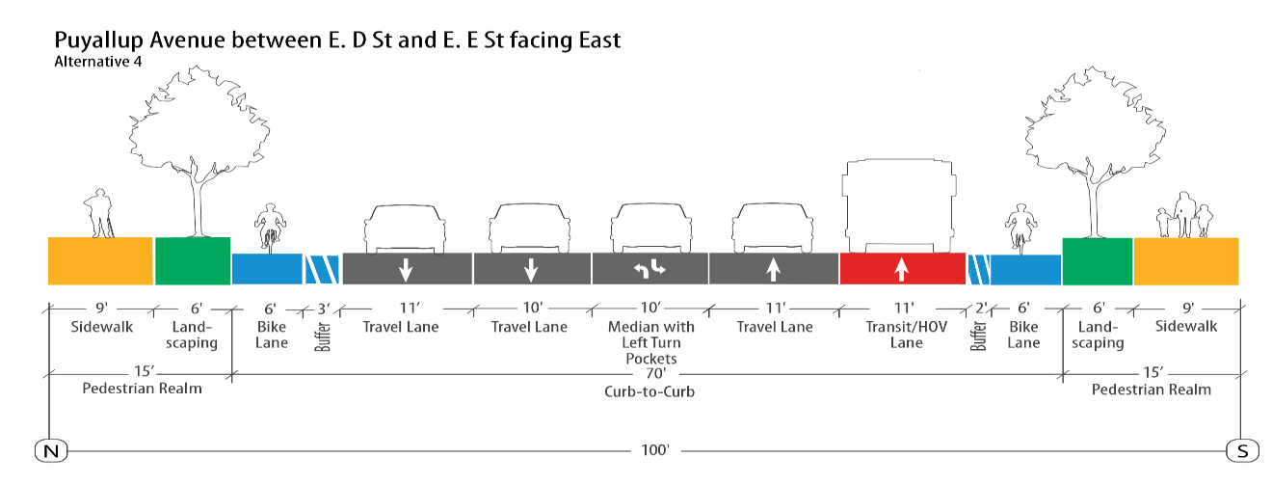
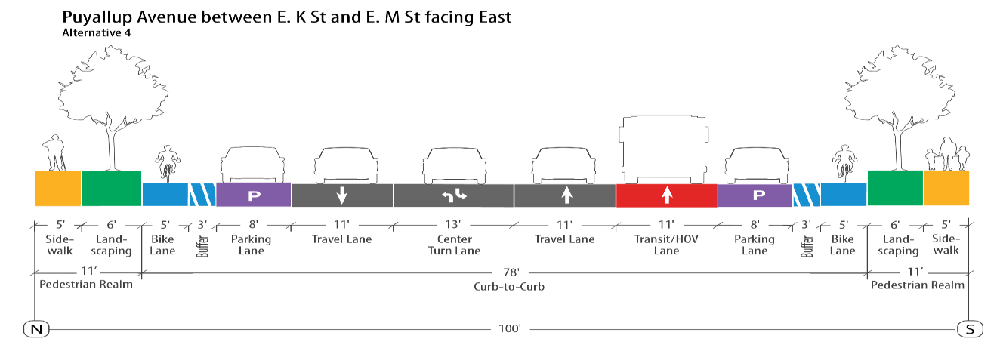
Hybrid Alternative 4 (no parking E. C St. to E. G St.)

Slide 11
Draft Concept Review – Parking on North Side
Dimensions/layout cannot be confirmed until survey is complete, right-of-way width determined, and feedback received from other stakeholders/regulators/designers.

Slide 12
Draft Concept Review – Parking on North Side
Dimensions/layout cannot be confirmed until survey is complete, right-of-way width determined, and feedback received from other stakeholders/ regulators/designers.

Slide 13
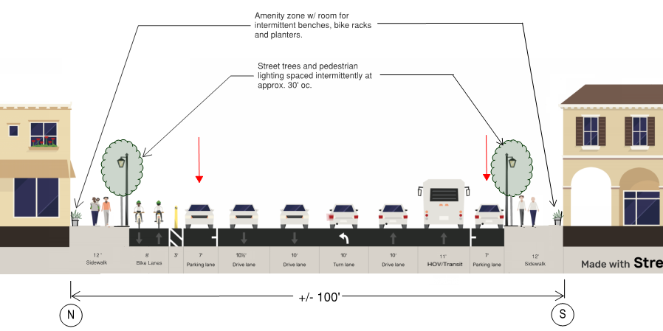
Draft Concept Review – Parking on Both Sides
Dimensions/layout cannot be confirmed until survey is complete, right-of-way width determined, and feedback received from other stakeholders/ regulators/designers.

Slide 14
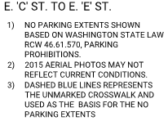
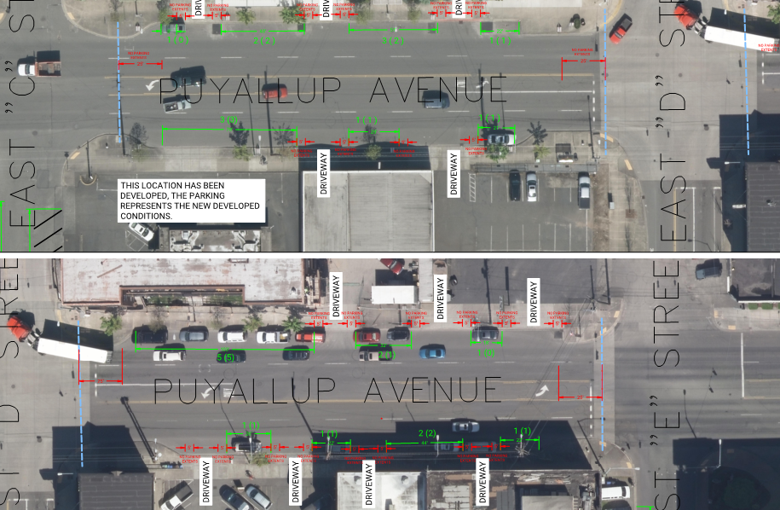
Draft/Concept Review – E. C St. to E. E St. Existing Puyallup Avenue On-Street Parking
No parking changes tentatively anticipated from E. E St. to E. G St. on Puyallup Ave.
Existing Stall Count:
11 North Side
10 South Side
21 Total Stalls

Slide 15
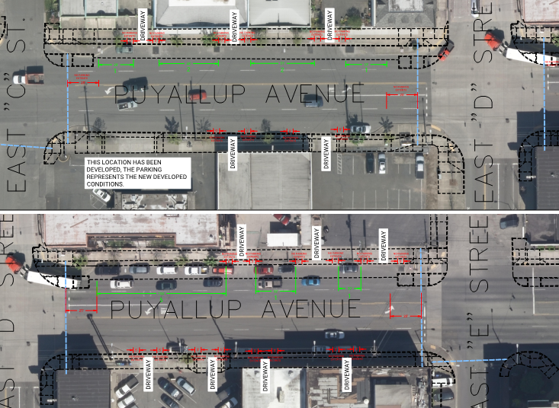
Draft/Concept Review – E. C St. to E. E St. Tentative/Proposed Puyallup Avenue North Side Parking
No parking changes tentatively anticipated from E. E St. to E. G St. on Puyallup Ave.
Tentative/Proposed Stall Count:
13 North Side
Tentative loss of 8 Puyallup Ave stalls
Dimensions/layout cannot be confirmed until survey is complete & stall placement reviewed by Traffic Section.
Final stall count may be significantly less than shown.

Slide 16
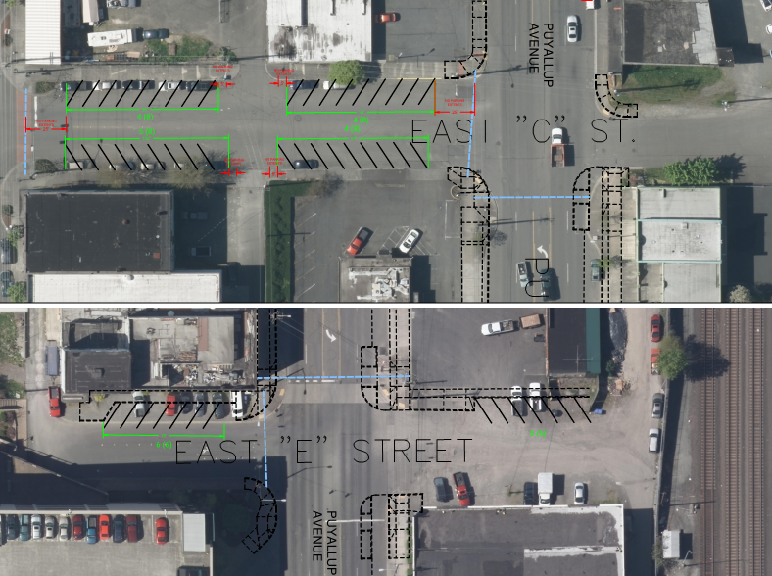
Draft/Concept Review – E. C St. to E. E St. Tentative Side Street Parking Options
Tentative/Proposed Stall Count:
23 Existing
44 Proposed
21 Gained
Dimensions/layout cannot be confirmed until survey is complete & stall placement reviewed by Traffic Section.
Final stall count may be significantly less than shown.

Slide 17
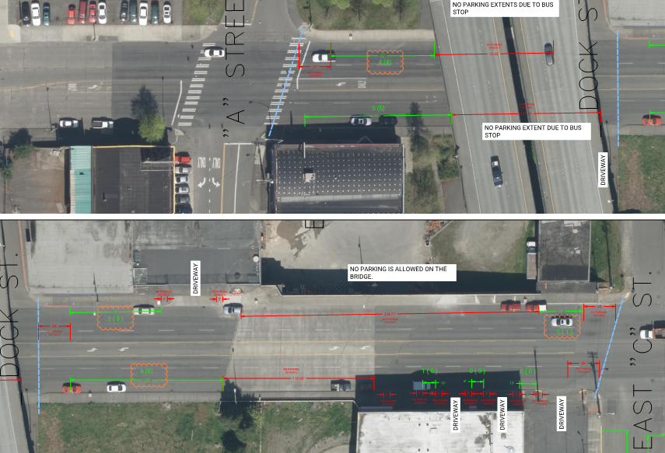
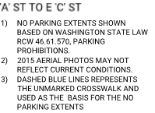
Draft/Concept Review – A St. to E. C St. Existing Puyallup Avenue On-Street Parking
No parking changes tentatively anticipated from E. E St. to E. G St. on Puyallup Ave.
Tentative/Proposed Stall Count:
19 Existing
14 Removed
5 Stalls Remain
Dimensions/layout cannot be confirmed until survey is complete & stall placement reviewed by Traffic Section.
Final stall count may be significantly less than shown.

Slide 18
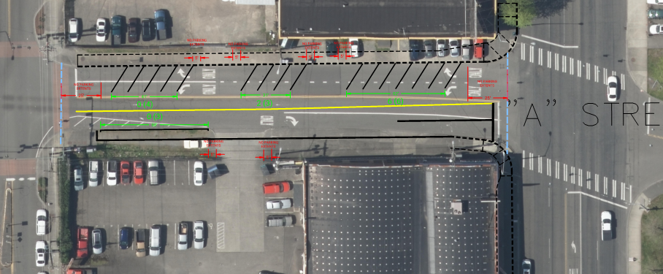
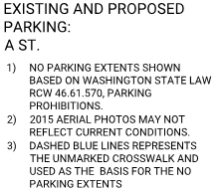
Draft/Concept Review – A St. to E. C St. Tentative Side Street Parking Options
Tentative/Proposed Stall Count:
8 Existing
16 Proposed
8 Gained
Dimensions/layout cannot be confirmed until survey is complete & stall placement reviewed by Traffic Section.
Final stall count may be significantly less than shown.

Slide 19
Design Criteria Summary
Segment 1: Neighborhood District - Pacific Ave to E. D St.
Maximize parking by:
Maintaining curb-side parking (no net loss along Puyallup Ave, if possible)
Added angle parking along side streets, to the extent possible
Wide sidewalks w/ walkable, pedestrian friendly amenity zones
Protective street-edge landscape / street-tree buffer
Pedestrian safety (lighting, CPTED)
Segment 2: TOD District - E. D St. to E. G St.
Same 4 bullets as in the Neighborhood District
Ease of crossing and access to transit
If available, consider TLDE improvements / connections in relation to Puyallup Ave design
Long term – Develop recommendations regarding use and timing of HOV / transit lane

Slide 20
Design Criteria Summary
Segment 3 - Industrial District - E. G St. to Portland Ave.
Gateway to Tacoma
Maintain parking
Consider higher freight use / improvements in this part of the corridor
Improved sidewalks and signage
Consider bicycle connections to destinations beyond Portland Avenue
Protective street-edge landscape / street-tree buffer
Pedestrian safety (lighting, CPTED)

Slide 21
Thank You!

